Slide 1
Part 2 Getting Started with RT Component Creation
Nobuhiko Miyamoto
National Institute of Advanced Industrial Science and Technology
Industrial Cyber-Physical Systems Research Center
Software Platform Research Team
Notes:
Now, let's start "Part 2 Introduction to RT Component Creation".

Slide 2
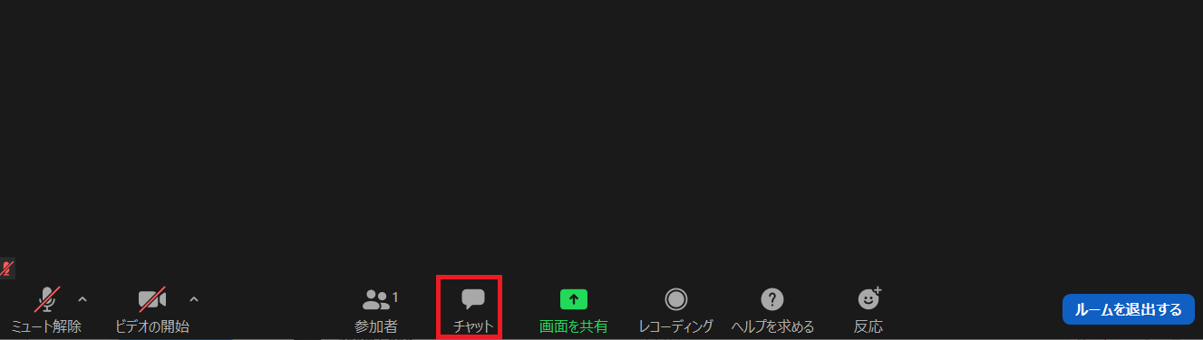
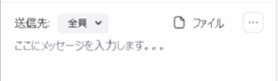
If you have any questions
Ask a question in Zoom’s chat.
Display the Zoom Group Chat screen
Please set the destination to everyone.
If the problem is not solved by chat, we will provide individual support.
2
Notes:
2
If you have any questions, please use Zoom’s chat.
If the problem is not solved by chat, we will provide individual support.

Slide 3
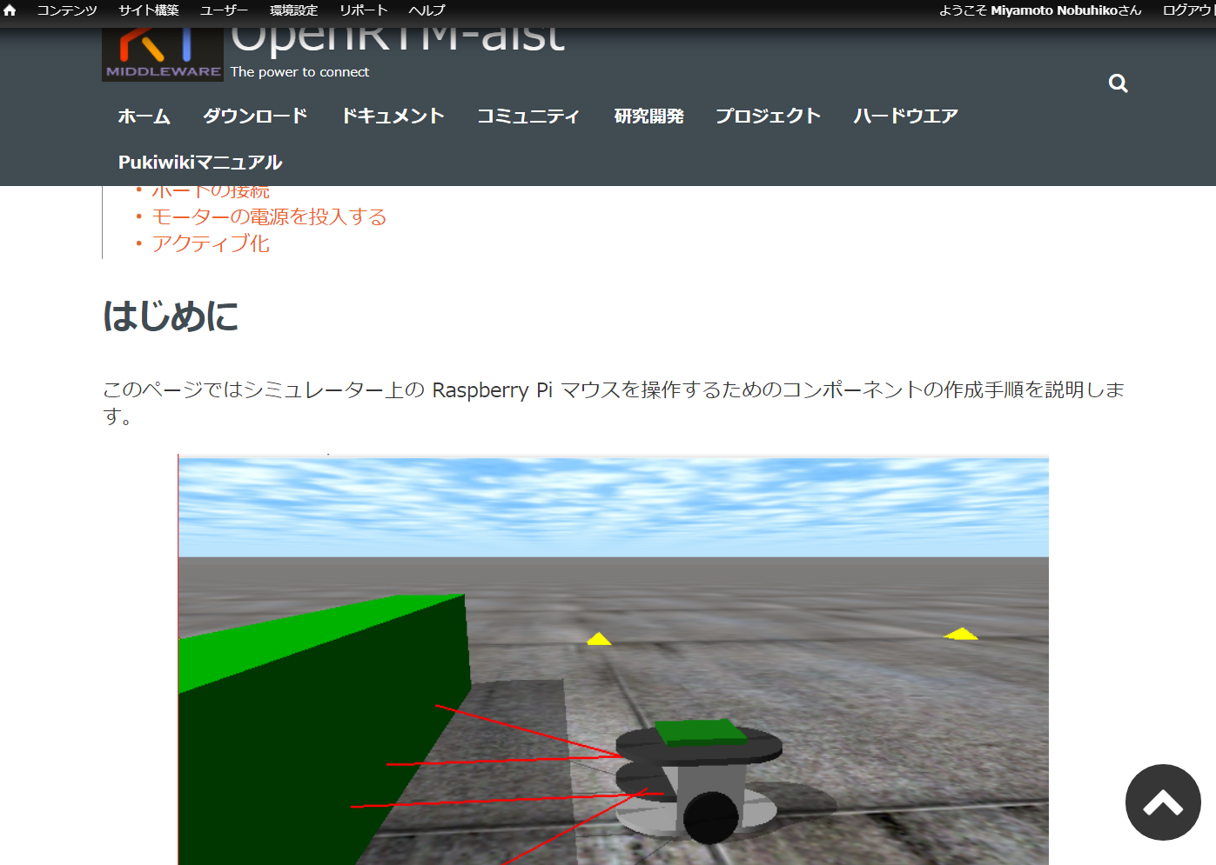
Document
Please, open the following WEB page
Windows
https://openrtm.org/openrtm/ja/doc/casestudy/raspberrypi_mouse/raspimouse_tutorial_rtm_seminar/tutorial_rtm_seminar_win_part2
Ubuntu
https://openrtm.org/openrtm/ja/doc/casestudy/raspberrypi_mouse/raspimouse_tutorial_rtm_seminar/tutorial_rtm_seminar_ubuntu_part2
3
Notes:
3
Please, open the following WEB page.
Send the URL in chat.

Slide 4
Outline of the training
Creating component to operate the mobile robot (Raspberry Pi Mouse) on the simulator.
Target speed input by GUI
Stops when the sensor value exceeds a certain level
4
Notes:
4
In this training, Let’s try creating an RTComponent to control a mobile robot on the simulator.
The Robot Controller Component commands the mobile robot to speed by GUI.
Also, the mobile robot should stop according to the value of the distance sensor.

Slide 5
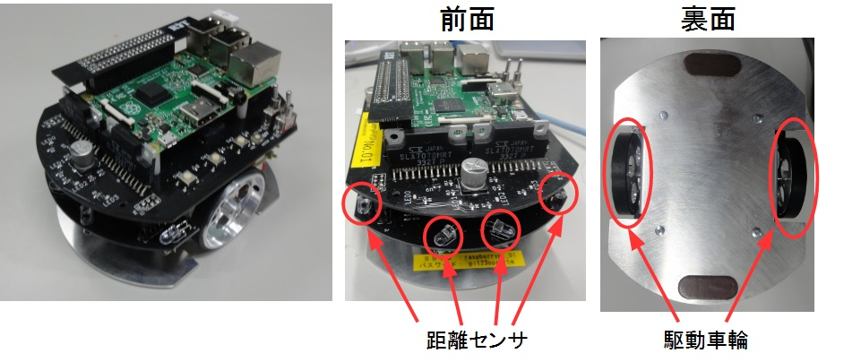
Raspberry Pi Mouse Overview
Raspberry Pi Mouse is an two-wheel drive mobile robot sold by RT.
Front
Back
Distance sensor
Drive wheels
5
Notes:
5
Raspberry Pi Mouse is an two-wheel drive mobile robot sold by RT.
Raspberry Pi mouse has four distance sensors on the front.

Slide 6
The procedure of the training
Creating a template for source code using RTC Builder
Edit source code and build.
Generate various files required for build
Various files generated by CMake
Editing source code
Editing RobotController.h and RobotController.cpp
Build
Visual Studio、Code::Blocks
RT System creation and operation check using RT System Editor
RT system creation
Data port connection, configuration parameter settings.
6
Notes:
6
The procedure of the training is lik
First, use RTC Builder to generate a source code template.
Second, edit the source code and build.
Finally, use RTSystemEditor to build the RT system and check its operation.

Slide 7
Component development tools
RTC Builder
Notes:
Now let's talk about the component development tool RTC Builder.

Slide 8

RTC Builder
A tool that enters component profile information and generates a template such as source code
Output C ++, Python, Java, Lua source code
8
Notes:
8
RTCBuilder is a tool that can output template code by inputting the profile information of the component.

Slide 9

Launch RTC Builder
Steps to start RTC Builder
Windows(OpenRTM-aist 1.2)
Double-click on the desktop shortcut
Ubuntu
Enter the following command
$ openrtp
9
Notes:
9
Now, I will explain the procedure to start RTC Builder.
If you are using Windows, double-click on the desktop shortcut.
If you are using Ubuntu, enter the command "openrtp".

Slide 10
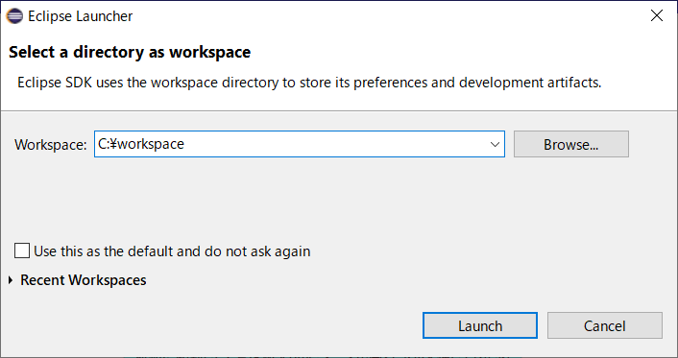
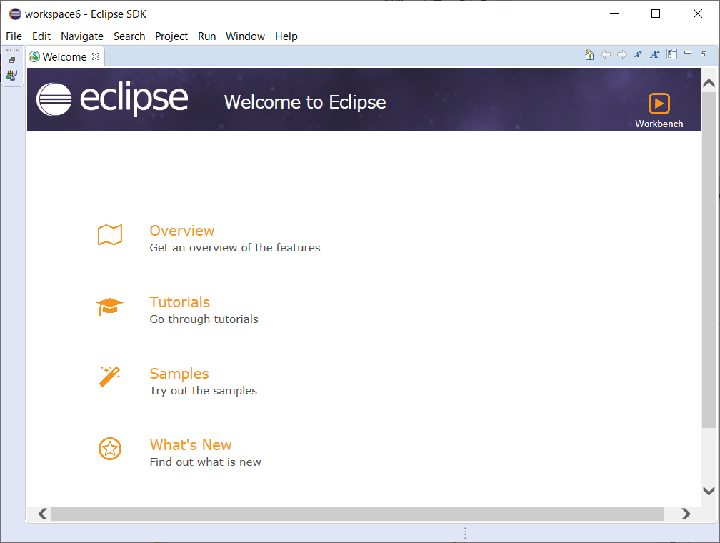
Start RTC Builder
Set any location in the workspace and click Launch.
The Welcome page opens when you first start OpenRTP, so close it.
10
Notes:
10
When the "Eclipse Lancher" screen opens, set any location in the workspace and click Launch.
日本語環境の場合は起動ボタンを押す。
The Welcome page opens when you first start OpenRTP, so close it.

Slide 11
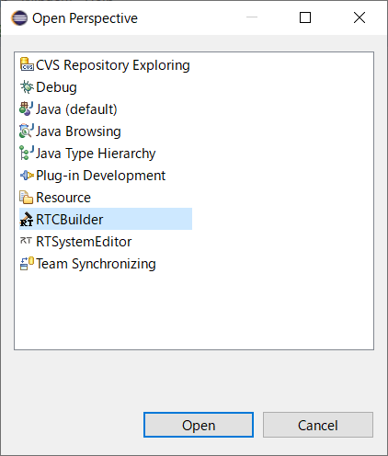
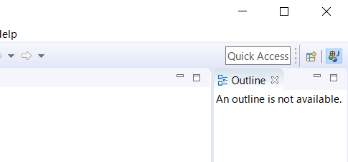
Launch RTC Builder
Click the "Open Perspective" button.
select "RTC Builder" and click the Open button.
11
Notes:
11
Then click the "Open Perspective" button.
When the "Open Perspective" screen is displayed, select "RTC Builder" and click the Open button.
日本語環境の場合は開くボタンを押す。

Slide 12
Project creation
Create skeleton code for the RobotController component.
Wheel type mobile robot operation component
Operate the robot with GUI
Stops when the sensor value exceeds a certain level
12
Notes:
12
First, create a Robot Controller Component project.

Slide 13
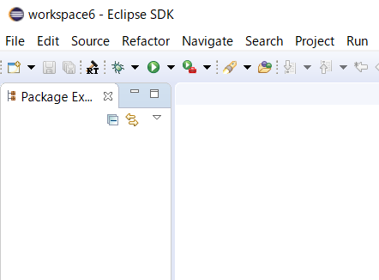
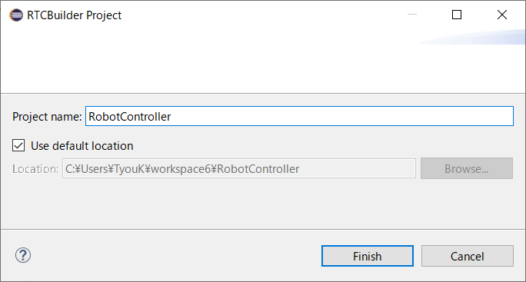
Project creation
Set "Robot Controller" to the project name and click finish.
Click the icon below
A folder called "RobotController" is created in the directory specified in the workspace when Eclipse starts.
At this point, only "RTC.xml" and ".project" are generated
The following items will be set
Basic profile
Activity profile
Data port profile
Service port profile
configuration
document
Language environment
RTC.xml
13
Notes:
13
Please click this icon.
When the "RTC Builder Project" screen is displayed, enter "Robot Controller" in the project name and click the finish button.
日本語環境では終了。
Then, the project is generated in the folder in the workspace.

Slide 14
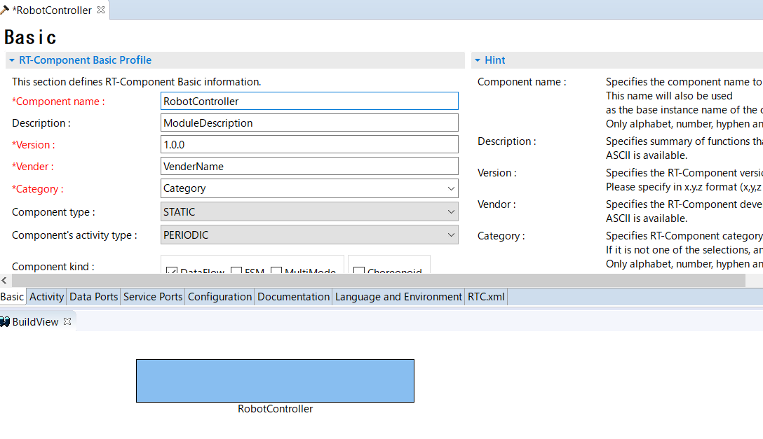
Enter basic profile
Set basic component information such as RT component profile information.
Code generation, import/export, packaging process
RTC profile editor
Enter each item here
Hint
Select the Basic tab.
14
Notes:
14
Please, select the Basic tab.
日本語は基本タブ。
From now on, you will enter basic information such as component names.

Slide 15
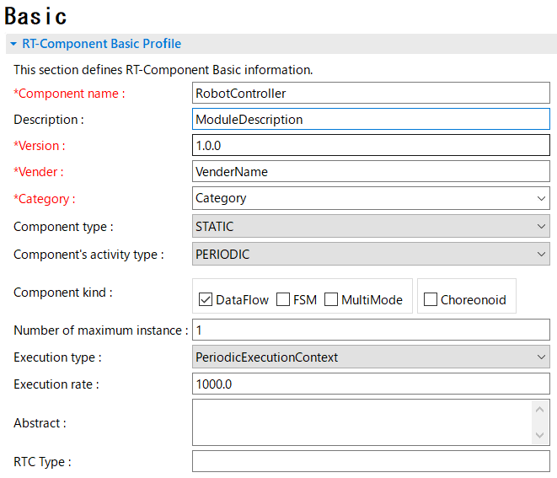
Enter basic profile
Component name
RobotController
Module overview
Optional (Robot Controller Component)
version
Optional (1.0.0)
Vendor name
Any
Module category
Optional (Controller)
Component type
STATIC
Activity type
PERIODIC
Component type
DataFlow
Maximum number of instances
1
Execution type
PeriodicExecutionContext
Execution cycle
1000.0
Overview
Any
15
Notes:
15
Please, set "Robot Controller" for the component name.
This is the only setting item on the basic tab.
日本語環境はコンポーネント名。

Slide 16
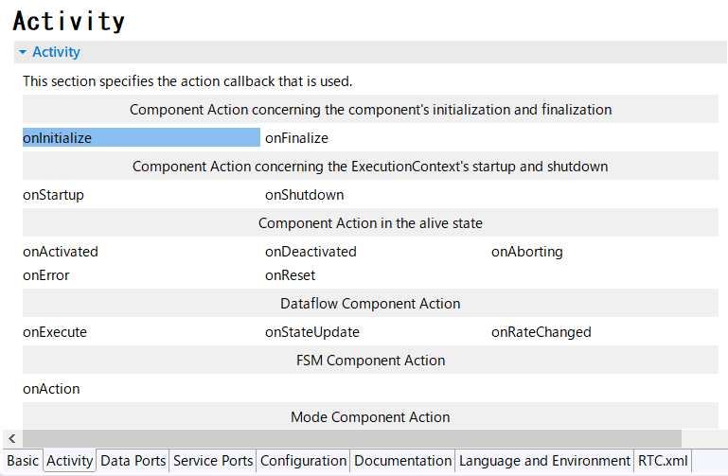
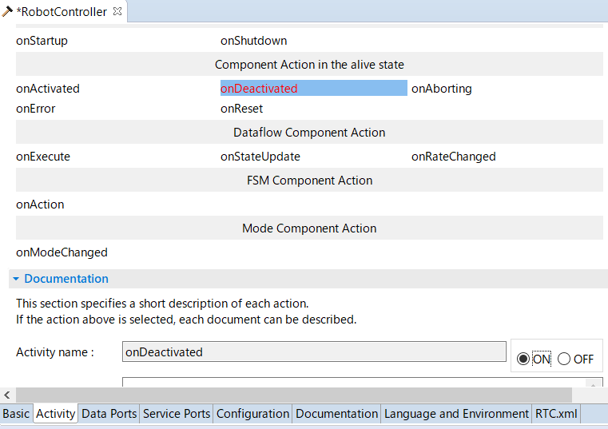
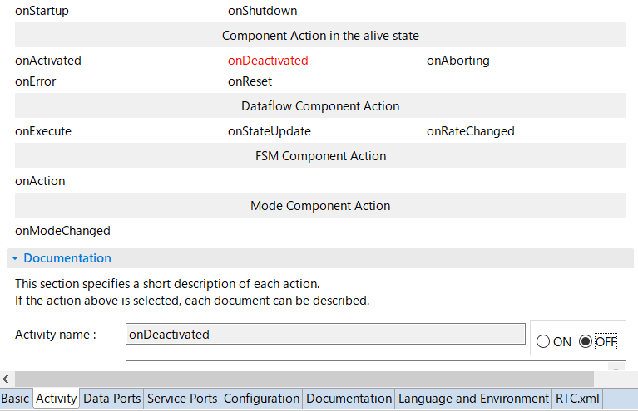
Activity settings
Set the activity to use.
Select the Activity tab.
Activated activity names have a blue background
Steps to enable specified activity
1. Select the activity name you want to use or not use
(Displayed in red when selected)
2. After selecting the activity name, select ON-OFF.
Notes:
16
Please, select the Activity tab.
This section describes how to set enabling the specified activity.
At first, Select the activity name you want to use or not use.
Second, After selecting the activity name, select ON-OFF.
Enabled activity names have a blue background.

Slide 17
Activity settings
コールバック関数 | 処理
onInitialize | Initialization process
onActivated | Called only once when activated
onExecute | Called periodically when active
onDeactivated | Called only once when deactivated
onAborting | Called only once before entering ERROR state
onReset | Called only once when reset
onError | Called periodically in ERROR state
onFinalize | Called only once at the end
onStateUpdate | Called every time after onExecute
onRateChanged | Called only once when the ExecutionContext rate changes
onStartup | Called only once when ExecutionContext starts execution
onShutdown | Called only once when ExecutionContext stops executing
17
Notes:
17

Slide 18

Activity settings
Enable the following activities
onInitialize
onActivated
onDeactivated
onExecute
18
Notes:
18
Please, Enable the onActivated, onDeactivated, and onExecute activities.

Slide 19
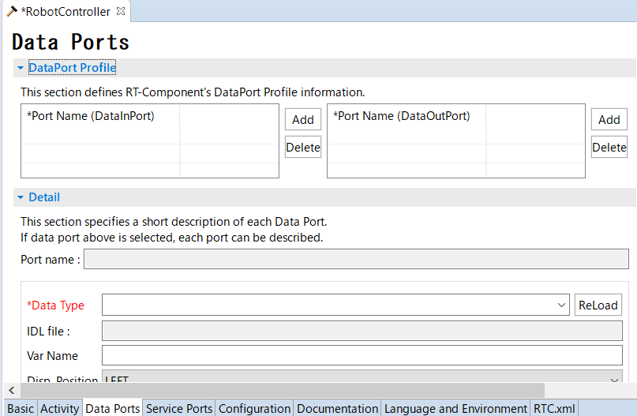
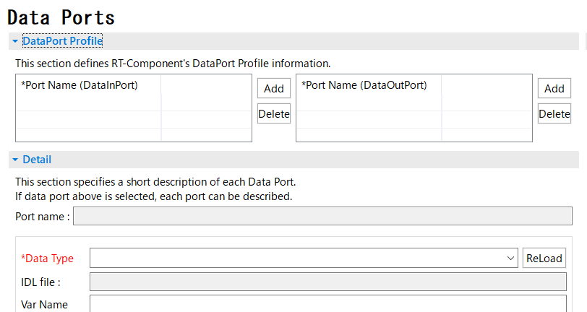
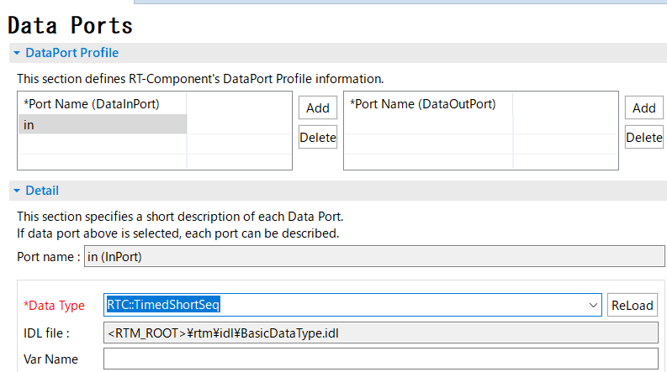
Data port settings
Add and set InPort and OutPort
Select the Data Port tab.
データポートを追加する手順
Click the port name to rename it.
Click the add button for ImPort or OutPort.
Set each item.
Notes:
19
Please, select the Data Port tab.
This section describes the procedure for adding a data port.
At first, click the add button for ImPort or OutPort.
Next, Click the port name to rename it.
Finaly, set items such as data type.

Slide 20
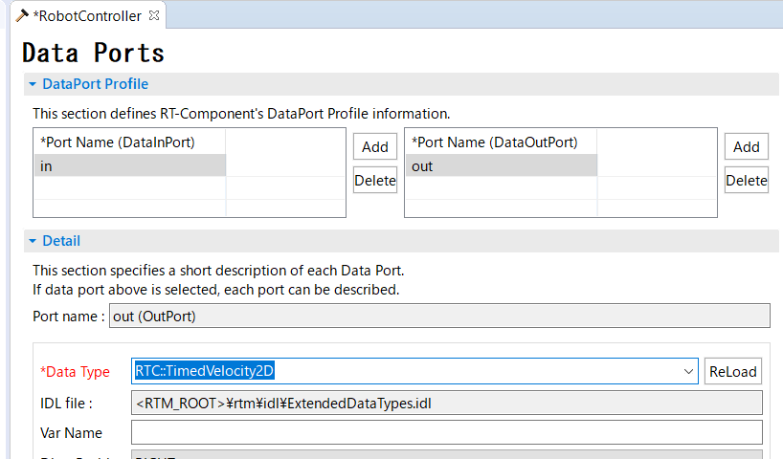
Data port settings
Set the following InPort
in
Data Type： RTC::TimedShortSeq
Please do not mistake it for Timed Short type.
Set the following OutPort
out
Data Type ： RTC::TimedVelocity2D
Please do not mistake it for TimedVelocity3D type and TimedVector2D.
Select the data type from the drop-down list.
Notes:
20
At first, add InPort, please.
Set the port name to "in“.
Second, add OutPort, please.
Set the port name to “out".

Slide 21


About the data port
Port for communicating continuous data
以下の例はデータフロー型がpush、サブスクリプション型がflush、インターフェース型がcorba_cdrの場合
Notes:
21

Slide 22
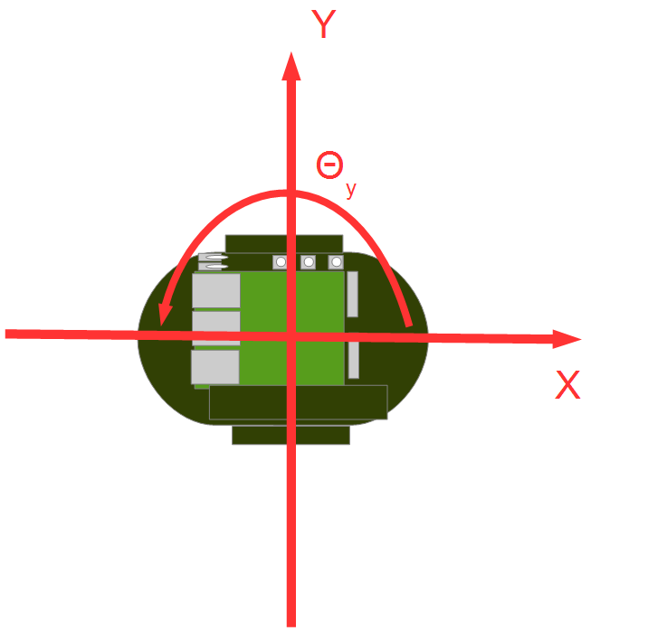

About RTC::TimedVelocity2D type
Data type for expressing the speed of a mobile robot defined in ExtendedDataTypes.idl.
vx: Velocity in the X-axis direction
vy: Velocity in the Y-axis direction (0 assuming the wheels do not skid)
va: Angular velocity around the Z axis
Set straight speed with vx and rotation speed with va
Notes:
22
By the way, TimedVelocity2D type is a data type that represents the speed of a mobile robot.
This data type can be set to translation speed vx, vy and rotation speed va.

Slide 23
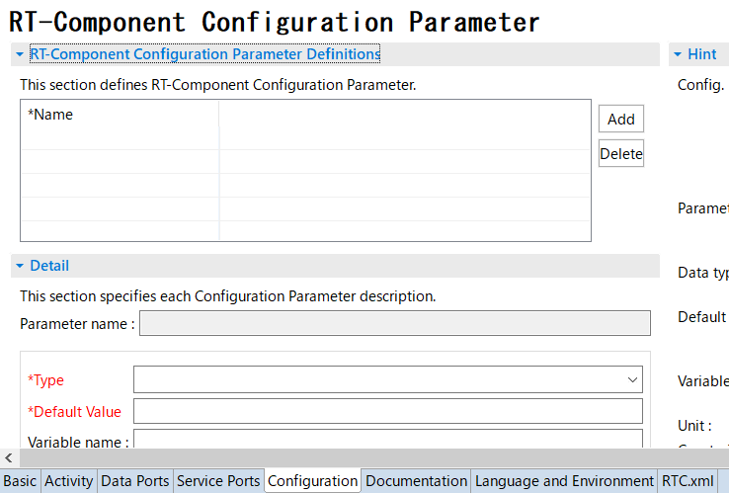
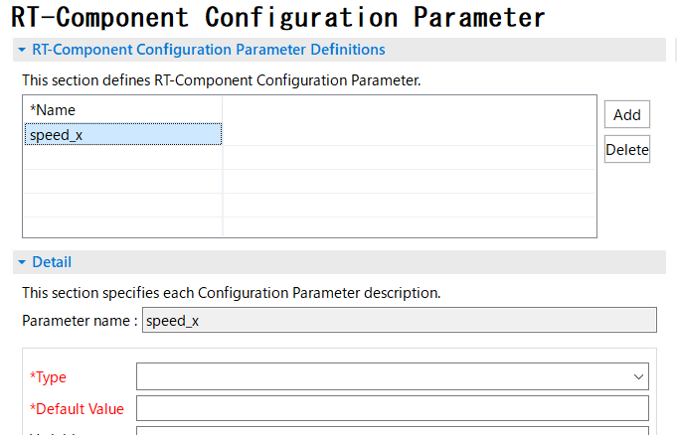
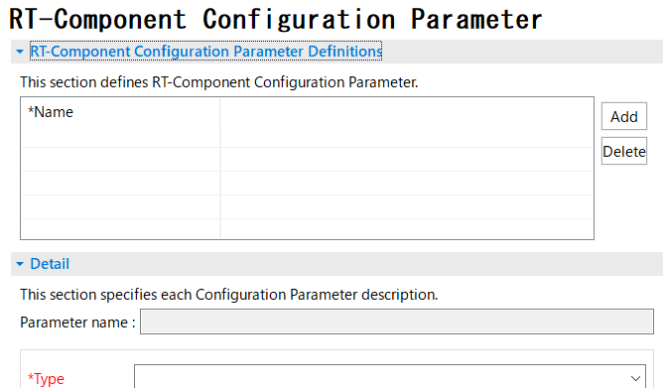
Configuration Parameter settings
Add and set configuration parameters
Select the Configuration tab.
コンフィギュレーションパラメータを追加する手順
Click the parameter name to rename it.
Click the add button.
Set each item.
Notes:
23
Please, select the Data Port tab.
This section describes the procedure for adding a configuration parameter.
At first, click the add button.
Next, Click the parameter name to rename it.
Finaly, set items such as data type.

Slide 24
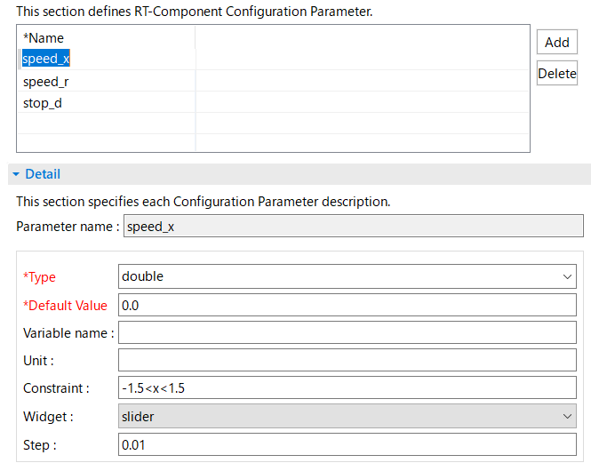

Configuration Parameter settings
Set the following configuration parameters
speed_x
Type：double
Default Value： 0.0
Constraint：-1.5<x<1.5
Widget：slider
Step: 0.01
speed_r
Type：double
Default Value： 0.0
Constraint ：-2.0<x<2.0
Widget：slider
Step: 0.01
Enable operation of mobile robots using GUI (slider)
Notes:
24
Add these configuration parameters, please.
The parameters of speed_x are Type is double, Default Value is 0.0, Constraint is -1.5 to 1.5 range, Widget is slider, and Step is 0.01.
The parameters of speed_r are Type is double, Default Value is 0.0, Constraint is -2.0 to 2.0 range, Widget is slider, and Step is 0.01.
Type：データ型
Constraint：制約条件

Slide 25

Configuration parameter constraints, and widget settings
Show GUI when editing configuration parameters in RT System Editor
Widget：text
Constraint：0<=x<=100
Widget：spin
Step：10
Constraint：0<=x<=100
Widget：slider
Step：10
Notes:
25

Slide 26



Configuration parameter constraints, and widget settings
Constraint：(0,1,2,3)
Widget：radio
Constraint：(0,1,2,3)
Widget：checkbox
Constraint：(0,1,2,3)
Widget：ordered_list
Notes:
26

Slide 27
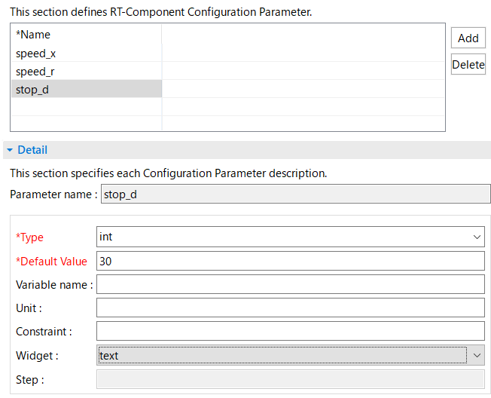
Configuration Parameter settings
Set the following configuration parameters
stop_d
Type：int
Default Value： 30
Stop when the sensor value is
greater than or equal to this value
Notes:
27
Add configuration parameters of stop_d, please.
The parameters of stop_d are Type is int, Default Value is 0.0, Constraint is -1.5 to 1.5 range, Widget is slider, and Step is 0.01.

Slide 28
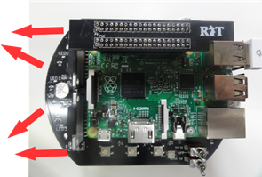
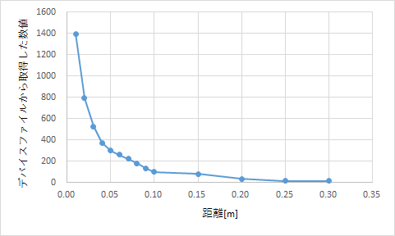
Raspberry Pi mouse distance sensor
Raspberry Pi mouse is equipped with a distance sensor
The measured value becomes larger as the distance to the object is shorter.
The simulator also calculates and outputs a value close to this data.
Notes:
28

Slide 29
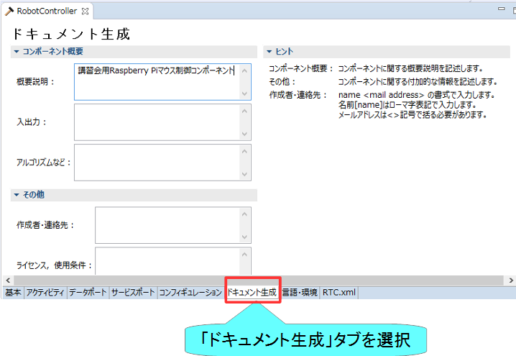
ドキュメントの設定
各種ドキュメント情報を設定
今回は適当に設定しておいてください。
空白でも大丈夫です
Notes:
29

Slide 30
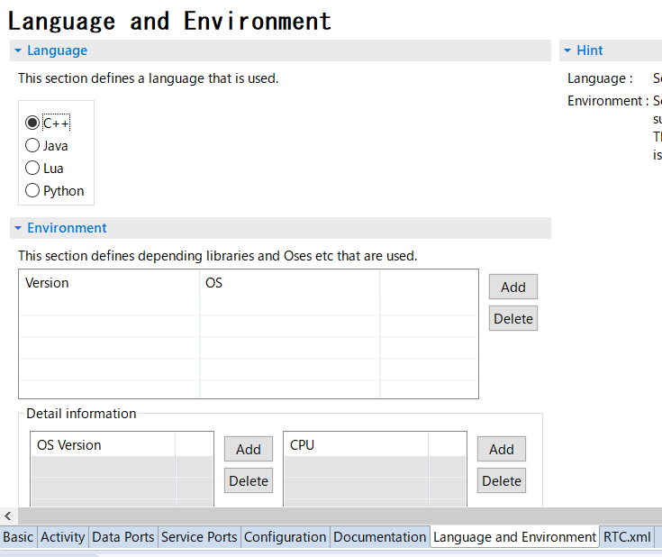
Language setting
Set information about the language to be implemented and the operating environment.
Set the language.
This time, set "C ++".
Select the Language and Environment tab.
Notes:
30
Please, select the Language and Environment tab.
Set the language to C ++, Please.
日本語環境：言語・環境

Slide 31
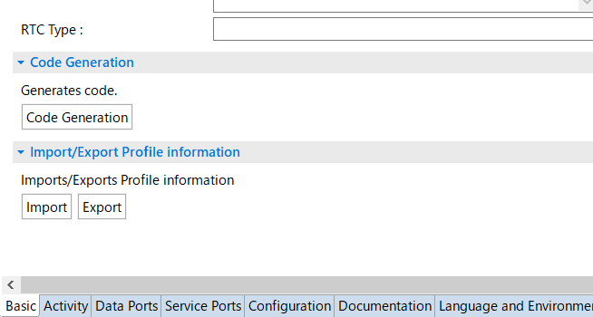
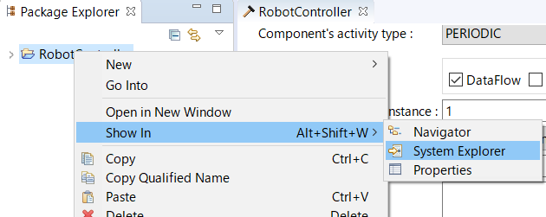
Skeleton code generation
A skeleton code is generated by pressing the code generation button from the basic tab.
Workspace\RobotController
Source code
C++ Source files(.cpp)
Header files (.h)
CMakeLists.txt
rtc.conf、RobotController.conf
etc.
Click the code generation button
Select the Basic tab.
Check the generated file
Right-click the created project and select “Show In“(表示方法)-> "System Explorer".
Explorer will open the workspace folder, so check if the above file exists
Right click on the created project
“Show In”-> “System Explorer”
Notes:
31
日本語環境：コード生成ボタン
Show In：表示方法

Slide 32
Edit source code, build RTC

Slide 33
Steps to build
Generate various files required for build
Various files generated by CMake
Edit the source code
Edit RobotController.h
Edit RobotController.cpp
Build
Windows： Visual Studio
Ubuntu： Code::Blocks
33
Notes:
33
This section describes the procedure up to the build execution.
At first, generate various files required for build by CMake.
Second, edit source code.
Finaly, run the build.

Slide 34
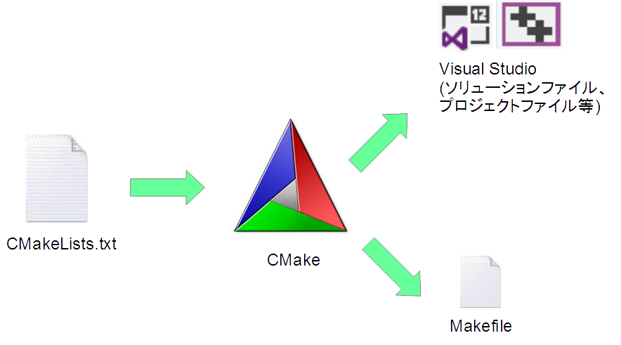
CMake
Generate various files required for build
Describe the settings in CMakeLists.txt.
CMakeLists.txt is also generated when you create the skeleton code in RTC Build
34
Notes:
34

Slide 35
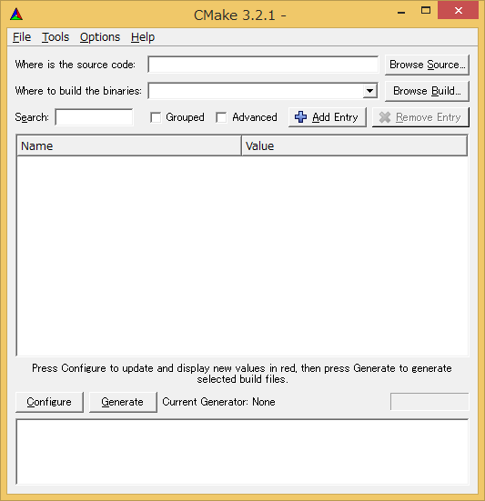
Generating files needed for build
Start CMake
Windows 7
「スタート」→「すべてのプログラム」→「CMake」→「CMake (cmake-gui)」
Windows 8.1
「スタート」→「アプリビュー(右下矢印)」→「CMake」→「CMake (cmake-gui)」
Windows 10
左下の「ここに入力して検索」にCMakeと入力して表示されたCMake(cmake-gui)を起動
Ubuntu
Enter the following command
cmake-gui
35
Notes:
35
Start CMake-gui, please.
If you are using Ubuntu, type "cmake-gui".

Slide 36
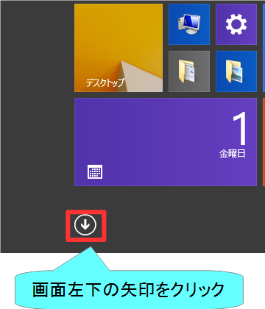
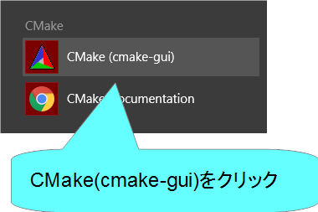
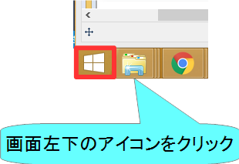
cmake-guiの起動
Windows 8.1
デスクトップ
スタート画面
アプリビュー
36
Notes:
36

Slide 37
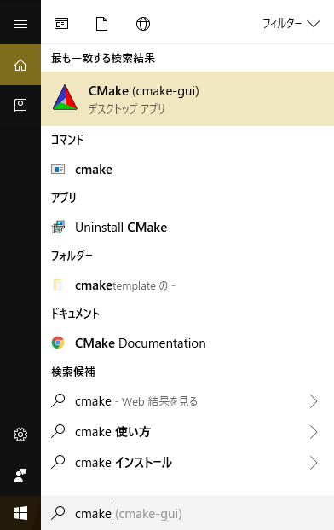
cmake-guiの起動
Windows 10
Enter "cmake" in "ここに入力して検索" at the bottom left
37
Notes:
37
If you are using Windows 10, search for cmake, please.

Slide 38
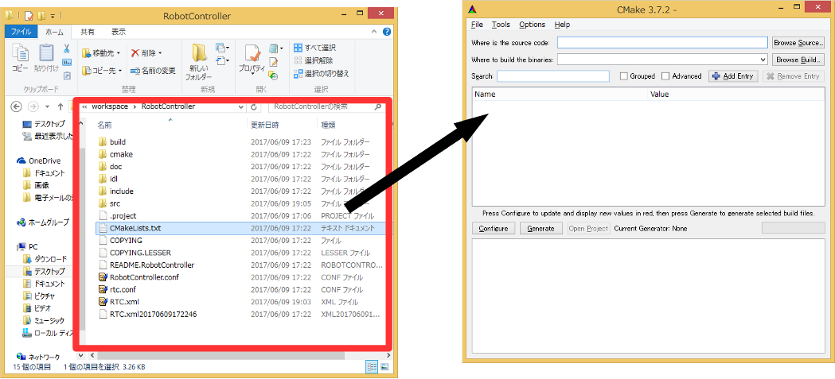
Generating files needed for build
Drag and drop CMakeLists.txt onto cmake-gui
CMakeLists.txt is a folder for projects generated by RTC Builder.
(例： C:\workspace\RobotController)
38
Notes:
38
Drag and drop CMakeLists.txt onto cmake-gui, please.
CMakeLists.txt is in the workspace project.

Slide 39
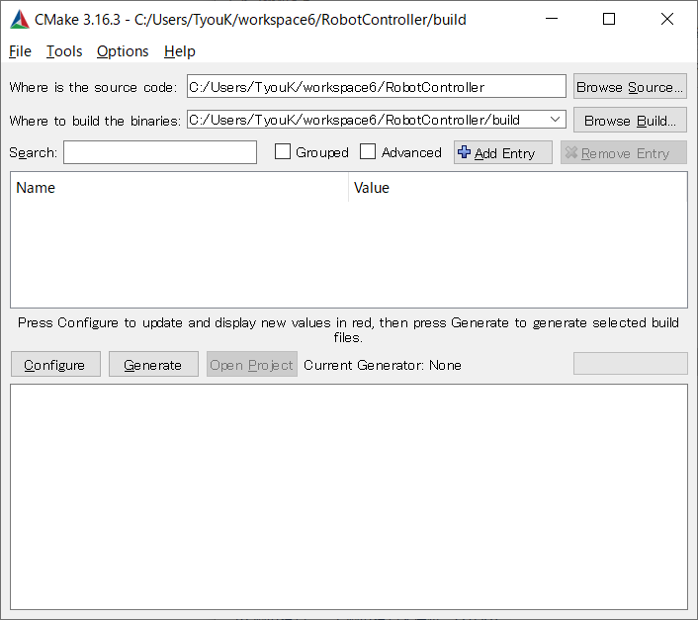
Generating files needed for build
Set the folder to generate solution files etc.
(e.g.:C:/workspace/RobotController/build)
Add "/build" after drag and drop.
39
Notes:
39
Please set the item of "Where to build the binaries".
"Where to build the binaries" sets the path of "Where is the source code" with "/build" added.

Slide 40
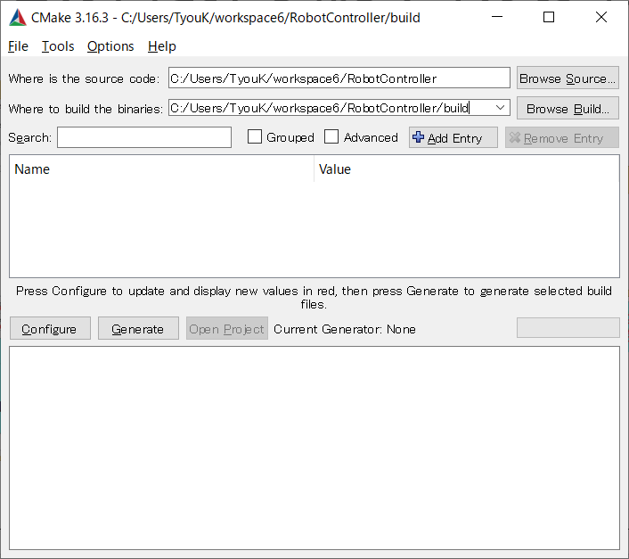
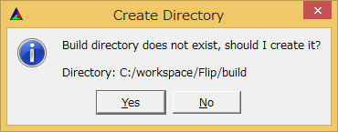
ビルドに必要なファイルの生成
Select YES
Click the Configure button.
Collect library information required for compilation.
40
Notes:
40
Click the Configure button, please.

Slide 41
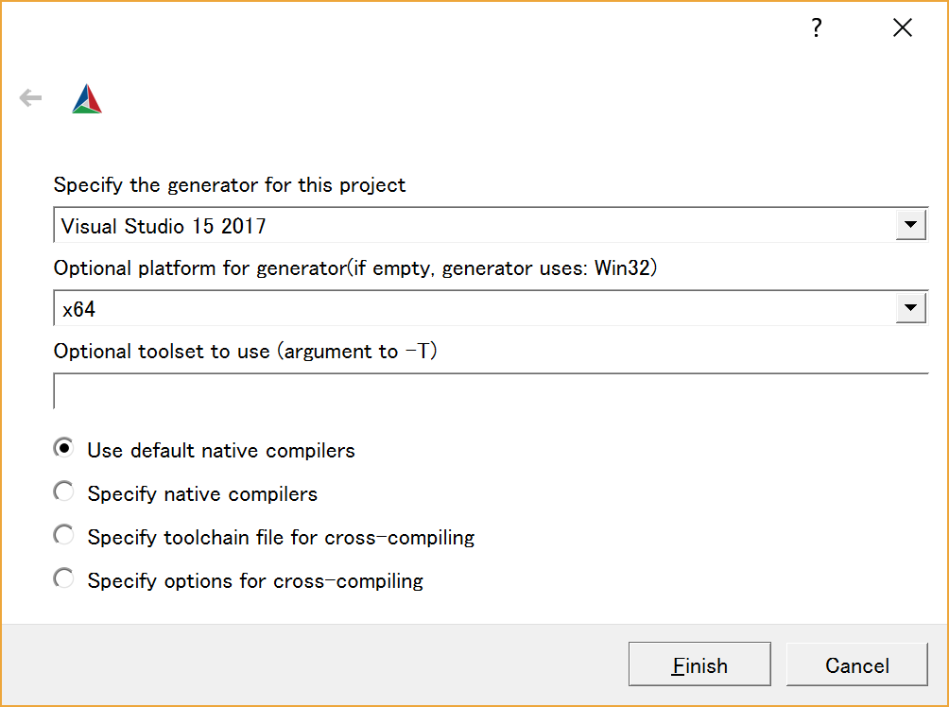
For CMake 3.14 or later
Build environment settings
Visual Studio 2017 → Visual Studio 15 2017
Visual Studio 2013 → Visual Studio 12 2013
Code::Blocks → CodeBlocks-Unix Makefiles
Select X64.
After setting, press the Finish button.
41
Notes:
41
The setting procedure when CMake is 3.14 or later is as shown in the slide.

Slide 42
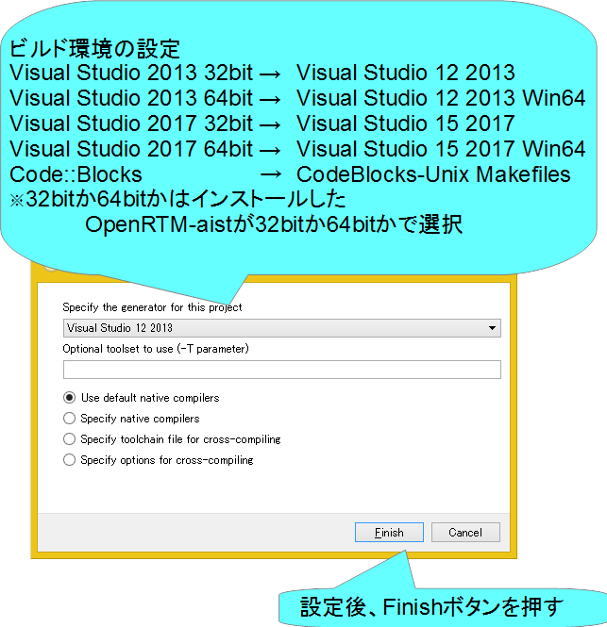
CMake 3.13以前の場合
42
Notes:
42
At first, I’d like to mention about RT.
What is RT?
RT means Robot Technology.
This is not only standalone robots like this, but also robotic elements, sensors, actuators and so on.
We have studied on RT-Middleware.
RT-Middleware is software platform to integrate these RT-elements.

Slide 43
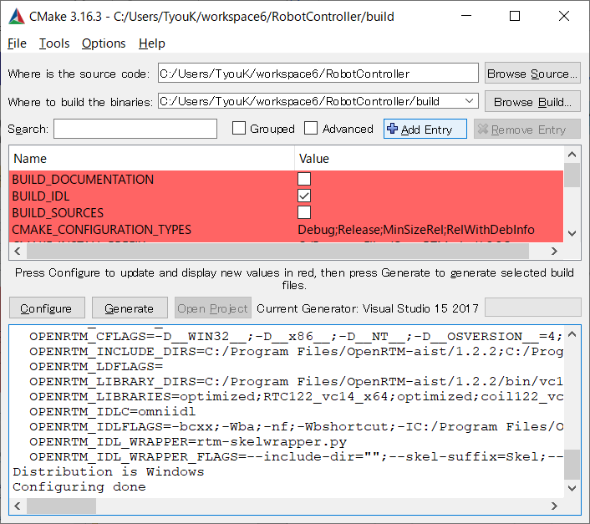
Generating files needed for build
If "Configure done" is displayed, it is successful.
43
Notes:
43
If "Configure done" is displayed, it is successful.
If you get an error, please use chat.

Slide 44
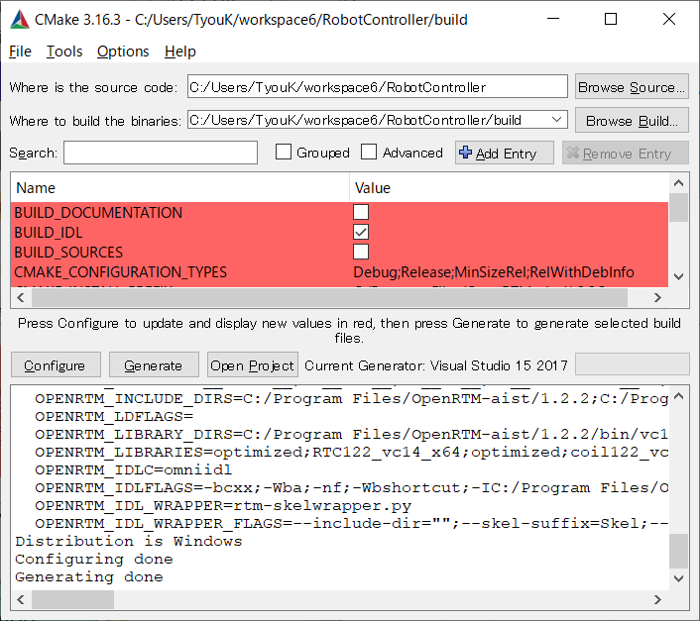
Generating files needed for build
Click the Generate button to generate the file.
If "Generating done" is displayed, it is successful.
44
Notes:
44
Click the Genarate button, please.
If "Generating done" is displayed, it is successful.

Slide 45

Editing source code
Click the "Open Project" button to start Visual Studio.
45
Notes:
45
Click the "Open Project“ button, please.

Slide 46
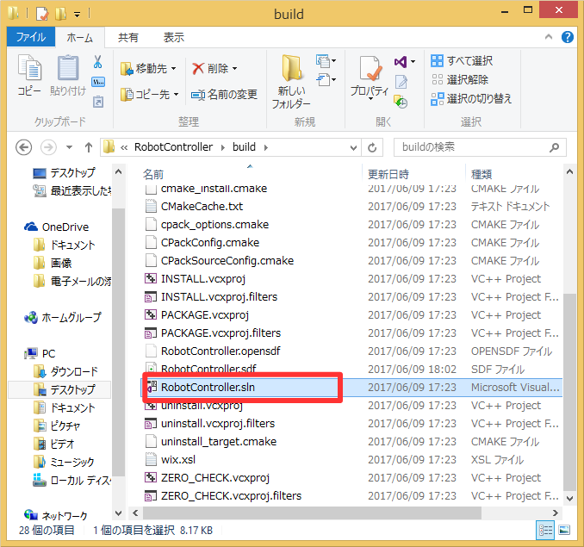
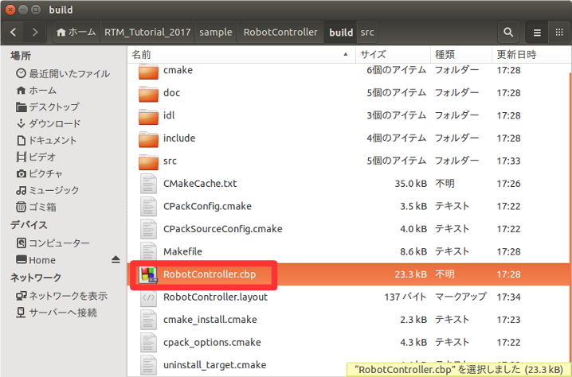
Editing source code
If the version of CMake-gui is old, there is no "Open Project" button, so double-click the file to open it.
Windows
le-click "RobotController.sln" in the build folder to open it
Ubuntu
Double-click "RobotController.cbp" in the build folder to open it.
46
Notes:
46
At first, I’d like to mention about RT.
What is RT?
RT means Robot Technology.
This is not only standalone robots like this, but also robotic elements, sensors, actuators and so on.
We have studied on RT-Middleware.
RT-Middleware is software platform to integrate these RT-elements.

Slide 47
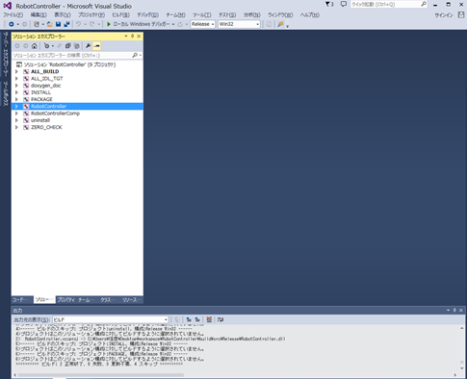
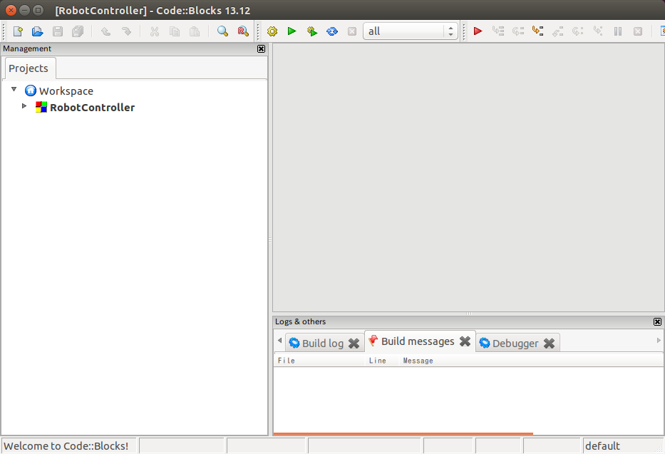
Editing source code
Windows
Visual Studio starts
Ubuntu
Code::Blocks starts
47
Notes:
47
Visual Studio will start if you are using Windows, and Code::Blocks will start if you are using Ubuntu.

Slide 48
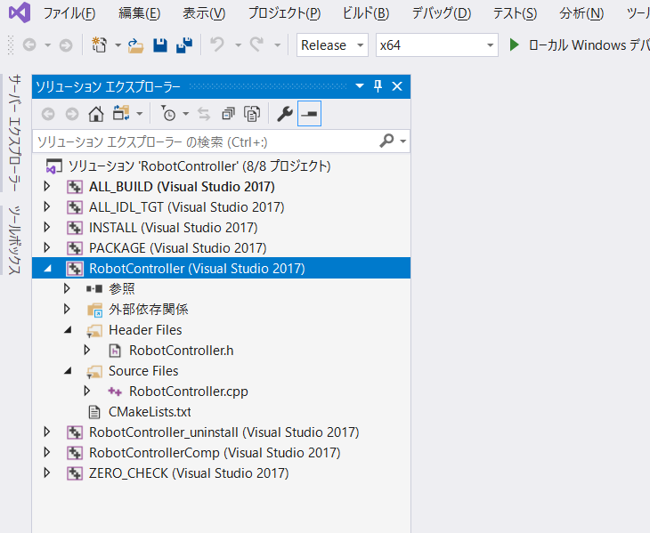

Editing source code
Edit RobotController.h
Visual Studio
Code::Blocks
Open RobotController.h from Solution Explorer
48
Notes:
48
Open RobotController.h from Solution Explorer, Please.

Slide 49

Editing source code
Edit RobotController.h
Declaration of a variable that temporarily stores the sensor value
int sensor_data[4];
49
Notes:
49
Please, edit RobotController.h.
Declare a variable to store the sensor value.

Slide 50

Editing source code
Edit RobotController.cpp
Visual Studio
Code::Blocks
Open RobotController.cpp from Solution Explorer
50
Notes:
50
Open RobotController.cpp from Solution Explorer, Please.

Slide 51


Editing source code
Edit RobotController.cpp
Added to onActivated function
Added to onDeativated function
51
Notes:
51
Please, edit RobotController.cpp.
Edit the onActivated function and onDeactivated function like this.

Slide 52

Editing source code
Edit RobotController.cpp
If it is difficult to write, please copy and paste from the following page.
https://openrtm.org/openrtm/ja/node/6550#toc20
Added to onExecute function
52
Notes:
52
Edit the onActivated function and onDeactivated function like this.

Slide 53

Editing source code
Procedure to read data
Check if there is newly written data with the isNew function
Read data with read function
Data is stored in the variable m_in when the read function is called.
TimedShortSeq type holds multiple data like an array.
53
Notes:
53

Slide 54

Editing source code
Procedure for writing data
Store data in the variable m_out.
Since it is a TimedVelocity2D type, the straight speed is stored in vx and the rotation speed is stored in va.
When the configuration parameter is changed, the value is stored in the corresponding variable (m_speed_x, m_speed_r, m_stop_d).
Write data with write function
54
Notes:
54
At first, I’d like to mention about RT.
What is RT?
RT means Robot Technology.
This is not only standalone robots like this, but also robotic elements, sensors, actuators and so on.
We have studied on RT-Middleware.
RT-Middleware is software platform to integrate these RT-elements.

Slide 55


RTC build
Visual Studio
Code::Blocks
If successful, an executable file will be generated.
Windows
RobotControllerComp.exe is generated in the Release (or Debug) folder of the build\src folder.
Ubuntu
RobotControllerComp is generated in the build/src folder
55
Notes:
55
Please, Compile the source code.

Slide 56
System construction support tool
RT System Editor
Notes:
Now let's talk about the System construction support tool
RTC System Editor.

Slide 57

RT System Editor
Tool for operating RTC with GUI
Data port and service port connection
Activate, deactivate, reset, exit
Manipulating configuration parameters
Manipulating the execution context
Change execution cycle
Execution context association
Composite
Launch RTC from manager
Save and restore the created RT system
57
Notes:
57
RT System Editor is Tool for operating RTC with GUI.
You can connect data ports and activate the RTC on the GUI.

Slide 58

Start RTSystemEditor
Click the "Open Perspective" button.
select "RTSystemEditor" and click the Open button.
58
Notes:
58
Then click the "Open Perspective" button.
When the "Open Perspective" screen is displayed, select "RTSystemEditor" and click the Open button.
日本語環境の場合は開くボタンを押す。

Slide 59

RT System Editor screen configuration
59
Notes:
59

Slide 60

Operation check of RobotController component
Create an RT system that connects to simulator components and operates robots on the simulator
Start Naming Service
Start RaspberryPiMouseSimulator Component
Windows
In the EXE folder of the extracted ZIP file
Double-click "RaspberryPiMouseSimulatorComp.exe"
Ubuntu
If not installed
$ wget https://raw.githubusercontent.com/OpenRTM/RTM_Tutorial_ROBOMECH2019/master/script/install_raspimouse_simulator.sh
$ sh install_raspimouse_simulator.sh
Go to the RasPiMouseSimulatorRTC directory and enter the following command
$ build/src/RaspberryPiMouseSimulatorComp
Start RobotController Component
Connect the RaspberryPiMouseSimulator component and RobotController component and execute "All Activate"
60
Notes:
60
From now on, Let’s try checking the operation of the RobotController component.
At First, start the simulator component.
Second, Start RobotController Component.
Finally, Connect Connect the RaspberryPiMouseSimulator component and RobotController component and execute "All Activate“.

Slide 61



Naming Service
A service that manages objects by name
Register the RTC with a unique name
Tools such as RT System Editor get object references by name from the name server
Procedure to start
If "localhost" is added to the left view, it is successful.
Click the “Start_NameService" button.
61
Notes:
61
Naming Service is A service that manages objects by name.
Please, start Naming Service.
At First, click the “Start_NameService" button.
If "localhost" is added to the left view, it is successful.

Slide 62



Start Naming Service
OpenRTM-aist 1.1.2以前の手順
Windows 7
「スタート」→「すべてのプログラム」→「OpenRTM-aist 1.2.0」→「Tools」→「Start Naming Service」
Windows 8.1
「スタート」→「アプリビュー(右下矢印)」→「OpenRTM-aist 1.2.0」→「Start Naming Service」
Windows 10
左下の「ここに入力して検索」にStart Naming Serviceと入力して起動
Ubuntu
$ rtm-naming
62
Notes:
62

Slide 63
Operation check of RobotController component
Create an RT system that connects to simulator components and operates robots on the simulator
Start Naming Service
Start RaspberryPiMouseSimulator Component
Windows
In the EXE folder of the extracted ZIP file
Double-click "RaspberryPiMouseSimulatorComp.exe"
Ubuntu
If not installed
$ wget https://raw.githubusercontent.com/OpenRTM/RTM_Tutorial_ROBOMECH2019/master/script/install_raspimouse_simulator.sh
$ sh install_raspimouse_simulator.sh
Go to the RasPiMouseSimulatorRTC directory and enter the following command
$ build/src/RaspberryPiMouseSimulatorComp
Start RobotController Component
Connect the RaspberryPiMouseSimulator component and RobotController component and execute "All Activate"
63
Notes:
63
Please, start RaspberryPiMouseSimulator Component.
RaspberryPiMouseSimulatorComp.exe is in the ZIP file.
Please, Double-click "RaspberryPiMouseSimulatorComp.exe“.
If you are using Ubuntu, enter these commands.
Next, start Robot Controller Component.
Please, execute RobotControllerCOmpo.exe.

Slide 64


Data port connection
Clicking this button launches System Diagram.
Drag and drop RaspberryPiouseSimulator0.rtc and RobotController0.rtc from the name service view on the left to the System Diagram.
Notes:
64
From now on, connect the data port and check the operation.
Please, click this button to open the system diagram.
Please, Drag and drop RaspberryPiouseSimulator0.rtc and RobotController0.rtc from the name service view on the left to the System Diagram.

Slide 65



Data port connection
Drag and drop "out" of RobotController0 to "target_velocity_in" of RaspberryPiMouseSimulator0
Click the OK button.
1. A line appears between the ports
2. InPort and OutPort are displayed in green
Notes:
65
Please, Drag and drop "out" of RobotController0 to "target_velocity_in" of RaspberryPiMouseSimulator0.
Click the OK button on the Connector Profile screen, please.
When the ports are connected, a line appears between the ports.

Slide 66

Data port connectionの接続
Connect "ir_sensor_out" of RaspberryPiSimulator0 and "in" of RobotController0.
Notes:
66
Please, connect "ir_sensor_out" of RaspberryPiSimulator0 and "in" of RobotController0.

Slide 67



Activation
Click the Activate Systems button.
If the RTC changes green, activation is successful.
If the button does not appear, restart OpenRTP.
Exit OpenRTP.
Double-click on the shortcut.
Notes:
67
From now on, let’s try activating the RTC.
Please, click the Activate Systems button.
If the RTC changes green, activation is successful.
If the button does not appear, restart OpenRTP.

Slide 68

Change configuration parameters
Change configuration parameters using RT System Editor
1. Click RobotController0.
2. Click the edit button.
Operate with the slider.
Check if the following operations can be performed
Can the robot on the simulator be operated with the slider?
Does the robot stop when it approaches an wall?
68
Notes:
68
Let's change the configuration parameters from the RTSystemEditor.
At first, click RobotController0.
Second, click the edit button.
Finally, Operate with the slider.
Please, Please check the operation.
Edit：編集

Slide 69



動作確認
When it stops when the wall approaches the distance sensor
Stop in front of the wall
Advance to the wall
When the wall does not stop when approaching the distance sensor
Continue to move forward even after touching the wall
69
Notes:
69
Please, Check if the robot stops in front of the wall.

Slide 70

RTコンポーネントの状態遷移
RTCには以下の状態が存在する
Created
生成状態
実行コンテキストを生成し、start()が呼ばれて実行コンテキストのスレッドが実行中(Runnning)状態になる
自動的にInactive状態に遷移する
Inactive
非活性状態
activate_componentメソッドを呼び出すと活性状態に遷移する
RT System Editor上での表示は青
Active
活性状態
onExecuteコールバックが実行コンテキストにより実行される
リターンコードがRTC_OK以外の場合はエラー状態に遷移する
RT System Editor上での表示は緑
Error
エラー状態
onErrorコールバックが実行コンテキストにより実行される
reset_componentメソッドを呼び出すと非活性状態に遷移する
RT System Editor上での表示は赤
終了状態
Notes:
70
At first, I’d like to mention about RT.
What is RT?
RT means Robot Technology.
This is not only standalone robots like this, but also robotic elements, sensors, actuators and so on.
We have studied on RT-Middleware.
RT-Middleware is software platform to integrate these RT-elements.

Slide 71


RTコンポーネントの状態遷移(生成直後)
Notes:
71
At first, I’d like to mention about RT.
What is RT?
RT means Robot Technology.
This is not only standalone robots like this, but also robotic elements, sensors, actuators and so on.
We have studied on RT-Middleware.
RT-Middleware is software platform to integrate these RT-elements.

Slide 72


RTコンポーネントの状態遷移(アクティブ化)
Notes:
72
At first, I’d like to mention about RT.
What is RT?
RT means Robot Technology.
This is not only standalone robots like this, but also robotic elements, sensors, actuators and so on.
We have studied on RT-Middleware.
RT-Middleware is software platform to integrate these RT-elements.

Slide 73


システムの保存
Notes:
73
At first, I’d like to mention about RT.
What is RT?
RT means Robot Technology.
This is not only standalone robots like this, but also robotic elements, sensors, actuators and so on.
We have studied on RT-Middleware.
RT-Middleware is software platform to integrate these RT-elements.

Slide 74




システムの復元
以下の内容を復元
ポート間の接続
コンフィギュレーション
「Open and Create Restore」を選択した場合はマネージャからコンポーネント起動
Notes:
74
At first, I’d like to mention about RT.
What is RT?
RT means Robot Technology.
This is not only standalone robots like this, but also robotic elements, sensors, actuators and so on.
We have studied on RT-Middleware.
RT-Middleware is software platform to integrate these RT-elements.

Slide 75


非アクティブ化、終了
非アクティブ化
終了
Notes:
75
At first, I’d like to mention about RT.
What is RT?
RT means Robot Technology.
This is not only standalone robots like this, but also robotic elements, sensors, actuators and so on.
We have studied on RT-Middleware.
RT-Middleware is software platform to integrate these RT-elements.

Slide 76


RTコンポーネントの状態遷移(非アクティブ化)
Notes:
76
At first, I’d like to mention about RT.
What is RT?
RT means Robot Technology.
This is not only standalone robots like this, but also robotic elements, sensors, actuators and so on.
We have studied on RT-Middleware.
RT-Middleware is software platform to integrate these RT-elements.

Slide 77

Raspberry Piマウス実機との接続
Raspberry PiとノートPCを無線LANで接続
Raspberry Piが無線LANアクセスポイントになる
注意事項
ノートPCに複数のネットワークインターフェースが存在する場合にRTCの通信ができなくなる可能性があります。
問題が発生した場合は個別に対応します。
Raspberry Piアクセスポイント接続後はインターネットに接続できなくなります。
Raspberry Piアクセスポイント接続後に、起動済みのネームサーバーとRTCは再起動してください。
Raspberry Piはシャットダウンしてから電源スイッチをオフにするようにしてください
モーター電源スイッチはこまめに切るようにしてください
Notes:
77
At first, I’d like to mention about RT.
What is RT?
RT means Robot Technology.
This is not only standalone robots like this, but also robotic elements, sensors, actuators and so on.
We have studied on RT-Middleware.
RT-Middleware is software platform to integrate these RT-elements.

Slide 78


Raspberry Piとの接続
Raspberry Piの電源投入
内側のスイッチをオンにする
電源を切る場合
3つ並んだスイッチの中央のボタンを1秒以上押す
10秒ほどでシャットダウンするため、その後に電源スイッチをオフにする
Notes:
78
At first, I’d like to mention about RT.
What is RT?
RT means Robot Technology.
This is not only standalone robots like this, but also robotic elements, sensors, actuators and so on.
We have studied on RT-Middleware.
RT-Middleware is software platform to integrate these RT-elements.

Slide 79


Raspberry Piとの接続
無線LANアクセスポイントとの接続
SSID、パスワードはRaspberry Piマウス上のシールに記載
接続手順(Windows)
画面右下のネットワークアイコンをクリック
raspberrypi_xxに接続後、パスワードを入力
Notes:
79
At first, I’d like to mention about RT.
What is RT?
RT means Robot Technology.
This is not only standalone robots like this, but also robotic elements, sensors, actuators and so on.
We have studied on RT-Middleware.
RT-Middleware is software platform to integrate these RT-elements.

Slide 80



ネームサーバーとの接続
Notes:
80
At first, I’d like to mention about RT.
What is RT?
RT means Robot Technology.
This is not only standalone robots like this, but also robotic elements, sensors, actuators and so on.
We have studied on RT-Middleware.
RT-Middleware is software platform to integrate these RT-elements.

Slide 81


起動済みのRTC、ネームサーバー再起動
ネームサーバーを再起動する
OpenRTM-aist 1.2の場合はネームサーバー起動ボタンで再起動
OpenRTM-aist 1.1.2の場合はネームサーバーのプロセス終了後、「Start Naming Service」を再度実行
RTC再起動
RTCをexitするか、RTC起動時に表示したウインドウの×ボタンを押して終了する
実行ファイル(RobotControllerComp.exe)を再度実行
Notes:
81
At first, I’d like to mention about RT.
What is RT?
RT means Robot Technology.
This is not only standalone robots like this, but also robotic elements, sensors, actuators and so on.
We have studied on RT-Middleware.
RT-Middleware is software platform to integrate these RT-elements.

Slide 82

ポートの接続
RobotController0とRapberryPiMouseRTC0を接続する
Notes:
82
At first, I’d like to mention about RT.
What is RT?
RT means Robot Technology.
This is not only standalone robots like this, but also robotic elements, sensors, actuators and so on.
We have studied on RT-Middleware.
RT-Middleware is software platform to integrate these RT-elements.

Slide 83

動作確認
モーターの電源投入
外側のスイッチをONにする
RTCをアクティブ化して動作確認
Notes:
83
At first, I’d like to mention about RT.
What is RT?
RT means Robot Technology.
This is not only standalone robots like this, but also robotic elements, sensors, actuators and so on.
We have studied on RT-Middleware.
RT-Middleware is software platform to integrate these RT-elements.

Slide 84




リセット
RTCがエラー状態に遷移した場合にエディタ上には赤く表示される。
以下の操作で非アクティブ状態に戻す
Notes:
84
At first, I’d like to mention about RT.
What is RT?
RT means Robot Technology.
This is not only standalone robots like this, but also robotic elements, sensors, actuators and so on.
We have studied on RT-Middleware.
RT-Middleware is software platform to integrate these RT-elements.

Slide 85


RTコンポーネントの状態遷移(エラー)
Notes:
85
At first, I’d like to mention about RT.
What is RT?
RT means Robot Technology.
This is not only standalone robots like this, but also robotic elements, sensors, actuators and so on.
We have studied on RT-Middleware.
RT-Middleware is software platform to integrate these RT-elements.

Slide 86


RTコンポーネントの状態遷移(リセット)
Notes:
86
At first, I’d like to mention about RT.
What is RT?
RT means Robot Technology.
This is not only standalone robots like this, but also robotic elements, sensors, actuators and so on.
We have studied on RT-Middleware.
RT-Middleware is software platform to integrate these RT-elements.

Slide 87
RTC Builder
補足

Slide 88


サービスポートの設定
サービスポートの追加、インターフェースの追加、設定を行う
Notes:
88
At first, I’d like to mention about RT.
What is RT?
RT means Robot Technology.
This is not only standalone robots like this, but also robotic elements, sensors, actuators and so on.
We have studied on RT-Middleware.
RT-Middleware is software platform to integrate these RT-elements.

Slide 89


サービスポートの設定
インターフェースを追加する
Notes:
89
At first, I’d like to mention about RT.
What is RT?
RT means Robot Technology.
This is not only standalone robots like this, but also robotic elements, sensors, actuators and so on.
We have studied on RT-Middleware.
RT-Middleware is software platform to integrate these RT-elements.

Slide 90



サービスポートの設定
インターフェースの設定を行う
コード生成後、Pythonの場合はidlcompile.bat(idlcompile.sh)を起動する
Notes:
90
At first, I’d like to mention about RT.
What is RT?
RT means Robot Technology.
This is not only standalone robots like this, but also robotic elements, sensors, actuators and so on.
We have studied on RT-Middleware.
RT-Middleware is software platform to integrate these RT-elements.

Slide 91

サービスポートの設定
IDLファイルについて
プログラミング言語に非依存のインターフェース定義言語
コンシュマー側でプロバイダ側のecho、get_valueなどのオペレーションを呼び出す
Notes:
91
At first, I’d like to mention about RT.
What is RT?
RT means Robot Technology.
This is not only standalone robots like this, but also robotic elements, sensors, actuators and so on.
We have studied on RT-Middleware.
RT-Middleware is software platform to integrate these RT-elements.

Slide 92


RTC Builderに関する設定
Notes:
92
At first, I’d like to mention about RT.
What is RT?
RT means Robot Technology.
This is not only standalone robots like this, but also robotic elements, sensors, actuators and so on.
We have studied on RT-Middleware.
RT-Middleware is software platform to integrate these RT-elements.

Slide 93

RTC Builderに関する設定
Notes:
93
At first, I’d like to mention about RT.
What is RT?
RT means Robot Technology.
This is not only standalone robots like this, but also robotic elements, sensors, actuators and so on.
We have studied on RT-Middleware.
RT-Middleware is software platform to integrate these RT-elements.

Slide 94


独自のデータ型の利用
独自のデータ型でデータポートの通信を行う手順
IDLファイルを作成する
MyDataType.idlを任意のフォルダ(ここではC:\UserDefType)作成
別のIDLファイルをインクルードしている場合は同じフォルダにコピーする
Notes:
94
At first, I’d like to mention about RT.
What is RT?
RT means Robot Technology.
This is not only standalone robots like this, but also robotic elements, sensors, actuators and so on.
We have studied on RT-Middleware.
RT-Middleware is software platform to integrate these RT-elements.

Slide 95

独自のデータ型の利用
独自のデータ型でデータポートの通信を行う手順
RTC Builderの設定でIDLファイルの存在するディレクトリを追加
Notes:
95
At first, I’d like to mention about RT.
What is RT?
RT means Robot Technology.
This is not only standalone robots like this, but also robotic elements, sensors, actuators and so on.
We have studied on RT-Middleware.
RT-Middleware is software platform to integrate these RT-elements.

Slide 96

独自のデータ型の利用
独自のデータ型でデータポートの通信を行う手順
Notes:
96
At first, I’d like to mention about RT.
What is RT?
RT means Robot Technology.
This is not only standalone robots like this, but also robotic elements, sensors, actuators and so on.
We have studied on RT-Middleware.
RT-Middleware is software platform to integrate these RT-elements.

Slide 97
RT System Editor
補足

Slide 98
コネクタプロファイルの設定
項目 | 設定内容
Name | 接続の名称
DataType | ポート間で送受信するデータの型．ex)TimedOctet,TimedShortなど
InterfaceType | データを送信方法．ex)corba_cdrなど
DataFlowType | データの送信手順．ex)push, pullなど
SubscriptionType | データ送信タイミング．送信方法がPushの場合有効．New, Periodic, Flushから選択
Push Rate | データ送信周期(単位：Hz)．SubscriptionTypeがPeriodicの場合のみ有効
Push Policy | データ送信ポリシー．SubscriptionTypeがNew，Periodicの場合のみ有効． all，fifo，skip，newから選択
Skip Count | 送信データスキップ数．Push PolicyがSkipの場合のみ有効
Notes:
98
At first, I’d like to mention about RT.
What is RT?
RT means Robot Technology.
This is not only standalone robots like this, but also robotic elements, sensors, actuators and so on.
We have studied on RT-Middleware.
RT-Middleware is software platform to integrate these RT-elements.

Slide 99

コネクタプロファイルの設定
InterfaceTye
データの送信方法
1.1.2ではcorba_cdr(CORBAによる通信)のみ選択可能
1.2.0では以下の通信方法も選択可能になる予定
direct(同一プロセスで起動したRTC間でデータを直接変数に渡す)
shared_memory(共有メモリによる通信)
DataFlowType
データの送信手順
Push
OutPortがInPortにデータを送る
Pull
InPortがOutPortに問い合わせてデータを受け取る
SubscriptionType
データ送信タイミング(DataFlowTypeがPush型のみ有効)
flush(同期)
バッファを介さず即座に同期的に送信
new(非同期)
バッファ内に新規データが格納されたタイミングで送信
periodic(非同期)
一定周期で定期的にデータを送信
Push Policy(SubscriptionTypeがnew、periodicのみ有効)
データ送信ポリシー
all
バッファ内のデータを一括送信
fifo
バッファ内のデータをFIFOで１個ずつ送信
skip
バッファ内のデータを間引いて送信
new
バッファ内のデータの最新値を送信(古い値は捨てられる)
Notes:
99
At first, I’d like to mention about RT.
What is RT?
RT means Robot Technology.
This is not only standalone robots like this, but also robotic elements, sensors, actuators and so on.
We have studied on RT-Middleware.
RT-Middleware is software platform to integrate these RT-elements.

Slide 100


コネクタプロファイルの設定
DataFlowType
Push
Pull
Notes:
100
At first, I’d like to mention about RT.
What is RT?
RT means Robot Technology.
This is not only standalone robots like this, but also robotic elements, sensors, actuators and so on.
We have studied on RT-Middleware.
RT-Middleware is software platform to integrate these RT-elements.

Slide 101


コネクタプロファイルの設定
SubscriptionType
flush(同期)
new、 periodic(非同期)
Notes:
101
At first, I’d like to mention about RT.
What is RT?
RT means Robot Technology.
This is not only standalone robots like this, but also robotic elements, sensors, actuators and so on.
We have studied on RT-Middleware.
RT-Middleware is software platform to integrate these RT-elements.

Slide 102

コネクタプロファイルの設定
項目 | 設定内容
Buffer length | バッファの大きさ
Buffer full policy | データ書き込み時に，バッファフルだった場合の処理．overwrite，do_nothing，blockから選択
Buffer write timeout | データ書き込み時に，タイムアウトイベントを発生させるまでの時間(単位:秒)
Buffer empty policy | データ読み出し時に，バッファが空だった場合の処理．readback，do_nothing，blockから選択
Buffer read timeout | データ読み出し時に，タイムアウトイベントを発生させるまでの時間(単位:秒)
Notes:
102
At first, I’d like to mention about RT.
What is RT?
RT means Robot Technology.
This is not only standalone robots like this, but also robotic elements, sensors, actuators and so on.
We have studied on RT-Middleware.
RT-Middleware is software platform to integrate these RT-elements.

Slide 103

サービスポートについて
コマンドレベルのやり取りを行うための仕組み
任意のタイミングで操作を行いたい時などに使用
例えばロボットアームのサーボを停止させる、ハンドを閉じる等
コンシューマ側がプロバイダ側が提供する関数群(オペレーション、メソッド)を呼び出す
インターフェースはIDLファイルで定義する。
Notes:
103
At first, I’d like to mention about RT.
What is RT?
RT means Robot Technology.
This is not only standalone robots like this, but also robotic elements, sensors, actuators and so on.
We have studied on RT-Middleware.
RT-Middleware is software platform to integrate these RT-elements.

Slide 104


サービスポートの接続
Notes:
104
At first, I’d like to mention about RT.
What is RT?
RT means Robot Technology.
This is not only standalone robots like this, but also robotic elements, sensors, actuators and so on.
We have studied on RT-Middleware.
RT-Middleware is software platform to integrate these RT-elements.

Slide 105

コンフィギュレーションパラメータについて
パラメータを外部から操作する仕組み
コンポーネント作成後に変更が必要なパラメータを設定する
例えばデバイスが接続されているCOMポート番号の設定等
Notes:
105
At first, I’d like to mention about RT.
What is RT?
RT means Robot Technology.
This is not only standalone robots like this, but also robotic elements, sensors, actuators and so on.
We have studied on RT-Middleware.
RT-Middleware is software platform to integrate these RT-elements.

Slide 106

コンフィギュレーションパラメータの設定
Notes:
106
At first, I’d like to mention about RT.
What is RT?
RT means Robot Technology.
This is not only standalone robots like this, but also robotic elements, sensors, actuators and so on.
We have studied on RT-Middleware.
RT-Middleware is software platform to integrate these RT-elements.

Slide 107



コンフィギュレーションパラメータの設定
方法1
方法2
Notes:
107
At first, I’d like to mention about RT.
What is RT?
RT means Robot Technology.
This is not only standalone robots like this, but also robotic elements, sensors, actuators and so on.
We have studied on RT-Middleware.
RT-Middleware is software platform to integrate these RT-elements.

Slide 108

マネージャの操作
CameraViewerComp.exe、OpenCVCameraComp.exeのプロセスではマネージャが起動している
マネージャがコンポーネントを起動する
Notes:
108
At first, I’d like to mention about RT.
What is RT?
RT means Robot Technology.
This is not only standalone robots like this, but also robotic elements, sensors, actuators and so on.
We have studied on RT-Middleware.
RT-Middleware is software platform to integrate these RT-elements.

Slide 109

マネージャの操作
Notes:
109
At first, I’d like to mention about RT.
What is RT?
RT means Robot Technology.
This is not only standalone robots like this, but also robotic elements, sensors, actuators and so on.
We have studied on RT-Middleware.
RT-Middleware is software platform to integrate these RT-elements.

Slide 110

マネージャの操作
マスターマネージャの起動、RT System Editorからの操作によるRTCの生成までの手順を説明する
rtc.confの設定
「manager.is_master」を「YES」に設定して起動するマネージャをマスターに設定する
manager.is_master: YES
モジュール探索パスの設定
manager.modules.load_path: ., C:\\Program Files (x86)\\OpenRTM-aist\\1.1.2\\Components\\C++\\Examples\\vc12
作成したrtc.confを設定ファイルの指定してrtcd.exeを起動する
rtcdはコマンドプロンプトからrtcd.exeを入力するか、OpenRTM-aistをインストールしたフォルダからコピーして使用する
rtcdはマネージャの起動のみを行う
～Comp.exeは起動時に特定のコンポーネントの起動も行う
RT Syetem Editorのネームサービスビューにマネージャが表示される
Notes:
110
At first, I’d like to mention about RT.
What is RT?
RT means Robot Technology.
This is not only standalone robots like this, but also robotic elements, sensors, actuators and so on.
We have studied on RT-Middleware.
RT-Middleware is software platform to integrate these RT-elements.

Slide 111

マネージャの操作
モジュールのロード
Notes:
111
At first, I’d like to mention about RT.
What is RT?
RT means Robot Technology.
This is not only standalone robots like this, but also robotic elements, sensors, actuators and so on.
We have studied on RT-Middleware.
RT-Middleware is software platform to integrate these RT-elements.

Slide 112

マネージャの操作
モジュールのロード
Notes:
112
At first, I’d like to mention about RT.
What is RT?
RT means Robot Technology.
This is not only standalone robots like this, but also robotic elements, sensors, actuators and so on.
We have studied on RT-Middleware.
RT-Middleware is software platform to integrate these RT-elements.

Slide 113



マネージャの操作
RTCの生成
Notes:
113
At first, I’d like to mention about RT.
What is RT?
RT means Robot Technology.
This is not only standalone robots like this, but also robotic elements, sensors, actuators and so on.
We have studied on RT-Middleware.
RT-Middleware is software platform to integrate these RT-elements.

Slide 114

実行コンテキストの操作
Notes:
114
At first, I’d like to mention about RT.
What is RT?
RT means Robot Technology.
This is not only standalone robots like this, but also robotic elements, sensors, actuators and so on.
We have studied on RT-Middleware.
RT-Middleware is software platform to integrate these RT-elements.

Slide 115

実行コンテキストの操作
実行周期の設定
Notes:
115
At first, I’d like to mention about RT.
What is RT?
RT means Robot Technology.
This is not only standalone robots like this, but also robotic elements, sensors, actuators and so on.
We have studied on RT-Middleware.
RT-Middleware is software platform to integrate these RT-elements.

Slide 116






実行コンテキストの操作
実行コンテキストの関連付け
RTC起動時に生成した実行コンテキスト以外の実行コンテキストと関連付け
関連付けた実行コンテキストでRTCを駆動させる
他のRTCとの実行を同期させる
Notes:
116
At first, I’d like to mention about RT.
What is RT?
RT means Robot Technology.
This is not only standalone robots like this, but also robotic elements, sensors, actuators and so on.
We have studied on RT-Middleware.
RT-Middleware is software platform to integrate these RT-elements.

Slide 117



実行コンテキストの操作
実行コンテキストの関連付け
Notes:
117
At first, I’d like to mention about RT.
What is RT?
RT means Robot Technology.
This is not only standalone robots like this, but also robotic elements, sensors, actuators and so on.
We have studied on RT-Middleware.
RT-Middleware is software platform to integrate these RT-elements.

Slide 118


複合コンポーネントの操作
複合コンポーネントの生成
Notes:
118
At first, I’d like to mention about RT.
What is RT?
RT means Robot Technology.
This is not only standalone robots like this, but also robotic elements, sensors, actuators and so on.
We have studied on RT-Middleware.
RT-Middleware is software platform to integrate these RT-elements.

Slide 119


複合コンポーネントの操作
複合コンポーネントの生成
Type
以下の3種類から選択可能
PeriodicECShared
実行コンテキストの共有
PeriodicStateShared
実行コンテキスト、状態の共有
Grouping
グループ化のみ
Notes:
119
At first, I’d like to mention about RT.
What is RT?
RT means Robot Technology.
This is not only standalone robots like this, but also robotic elements, sensors, actuators and so on.
We have studied on RT-Middleware.
RT-Middleware is software platform to integrate these RT-elements.

Slide 120

複合コンポーネントの操作
Notes:
120
At first, I’d like to mention about RT.
What is RT?
RT means Robot Technology.
This is not only standalone robots like this, but also robotic elements, sensors, actuators and so on.
We have studied on RT-Middleware.
RT-Middleware is software platform to integrate these RT-elements.

Slide 121


複合コンポーネントの操作
Notes:
121
At first, I’d like to mention about RT.
What is RT?
RT means Robot Technology.
This is not only standalone robots like this, but also robotic elements, sensors, actuators and so on.
We have studied on RT-Middleware.
RT-Middleware is software platform to integrate these RT-elements.

Slide 122


ゾンビの削除
RTCのプロセスが異常終了する等してネームサーバーにゾンビが残った場合、以下の手順で削除する
Notes:
122
At first, I’d like to mention about RT.
What is RT?
RT means Robot Technology.
This is not only standalone robots like this, but also robotic elements, sensors, actuators and so on.
We have studied on RT-Middleware.
RT-Middleware is software platform to integrate these RT-elements.

Slide 123

RT System Editorに関する設定
Notes:
123
At first, I’d like to mention about RT.
What is RT?
RT means Robot Technology.
This is not only standalone robots like this, but also robotic elements, sensors, actuators and so on.
We have studied on RT-Middleware.
RT-Middleware is software platform to integrate these RT-elements.

Slide 124



How to check the progress
Check with Zoom's "Raise Hand Button"
Display the participant's screen.
Raise your hand if there is a problem
If it is resolved, lower your hand
124
Notes:
124
We may check the progress during the training.
If you have any trouble, please use raise hand button.

